Slide 1
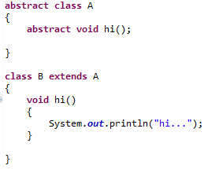
Abstract class in Java
Method that are declared without any body within an abstract class is known as abstract method.
The method body will be defined by its subclass.
Abstract method can never be final and static.
Any class that extends an abstract class must implement all the abstract methods declared by the super class.
Syntax :
abstract return_type function_name (); // No definition

